Slide 1
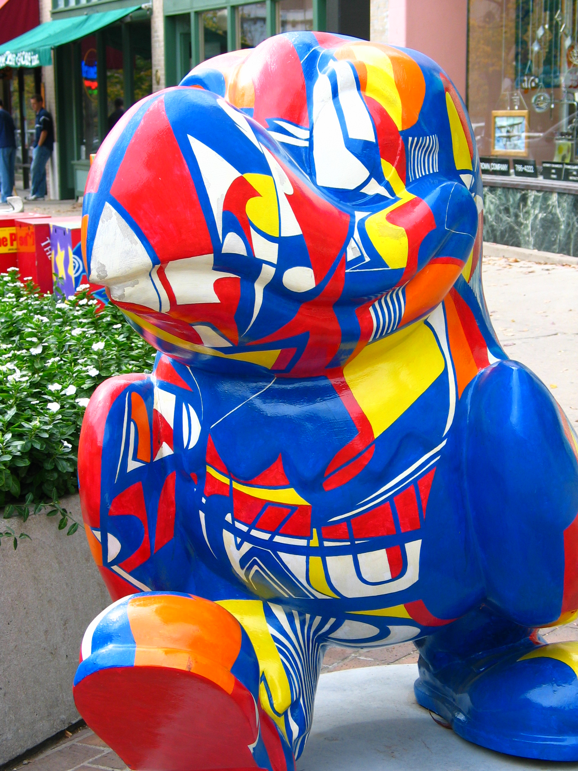
Facilities & Administrative Cost Rate Proposal
Jeff Hunter & Brad Barker
Financial Reporting Services

Slide 2
Regulations and Regulators
Office of Management & Budget Uniform Guidance
Cognizant Agency: Department of Health & Human Services, Division of Cost Allocation, Dallas Region

Slide 3
Why do we need this?
Standardized recovery: One rate agreement for all Federally-sponsored projects, applied to to other sponsors as well. Industry has a special rate
Reimbursement of indirect costs: Cost recovery for the use of our infrastructure, a portion of which is returned to the department/unit

Slide 4
Direct and Facilities and Administrative Costs
Direct Costs: Costs which can be identified specifically with a particular sponsored project or that can be directly assigned to such activities relatively easily with a high degree of accuracy
Facilities & Administrative: Costs incurred for common or joint objectives and therefore cannot be identified readily and specifically with a sponsored project

Slide 5
FACILITIES AND ADMINISTRATION (F&A) COST CALCULATION
DIRECT COST POOLS These become the denominator (base) in the rate calculations
MODIFIED TOTAL
COSTS
Depreciation of
Building & Equip
Instruction
Operations &
Maintenance
Library
Organized
Research
General &
Administrative
Departmental
Administration
Other Sponsored
Activities
Sponsored Project
Administration
F&A COST POOLS After cross-allocations – these become the numerator in the rate calculations
Other Institutional
Activities
Student Services
Administration

Slide 6
What is MTDC?
Modified Total Direct Cost
Total cost, less - equipment - capital expenditures - patient care - rental costs - scholarships and fellowships - subcontracts > $25k - tuition remission

Slide 7
Costs Are Distributed Based on Activity
Instruction
Organized Research
Other Sponsored Activity
Other Institutional Activities

Slide 8
Simplified F&A Rate Calculation
Numerator Expenses:
Library
Building Depreciation
Operation & Maintenance (Utilities)
General Administration (Payroll)
Department Administration (Dean, Business Mgr.)
Sponsored Projects Administration
= F & A Rate
For Research
Denominator Expenses:
Sponsored Research
University Research
Cost Sharing/Matching

Slide 9
FACILITIES AND ADMINISTRATION (F&A) COST CALCULATION
DIRECT COST POOLS These become the denominator (base) in the rate calculations
MODIFIED TOTAL
COSTS
Depreciation of
Building & Equip
Instruction
Operations &
Maintenance
Library
Organized
Research
General &
Administrative
Departmental
Administration
Other Sponsored
Activities
Sponsored Project
Administration
F&A COST POOLS After cross-allocations – these become the numerator in the rate calculations
Other Institutional
Activities
Student Services
Administration

Slide 10
Facilities & Administrative Cost Calculation - Overview
FACILITIES & ADMINISTRATIVE COST CALCULATION
–
OVERVIEW
FACILITIES & ADMINISTRATIVE COST CALCULATION
–
OVERVIEW
Cross
F&A
Allocation
F&A Costs
Distribution
F&A Cost
Allocations
Cost Pools
Bases
Allocated To
Base
Rates
Building and
Building and
Space
Equipment
Space
Equipment
Depreciation
Depreciation
Space
MTDC
Space
Interest
Instruction and
MTDC
Interest
Instruction and
Instruction and
Departmental
/
Instruction and
%
Departmental
Departmental
=
%
Research
Departmental
Space
Research
Research
Operations and
Research
Operations and
Space
Maintenance
Maintenance
MTDC
Organized
MTDC
MTC
Organized
/
Organized
%
General
Research
Organized
=
%
General
Research
Research
Administration
Research
MTC
Administration
MTDC
Other
MTDC
MTDC
Other
Other
Department
/
Other
=
%
Department
Sponsored
%
Sponsored
Sponsored
Administration
Sponsored
Administration
Activities
Activities
Activities
Activities
Sponsored Projects
MTDC
Sponsored Projects
Administration
Administration
1
Population including
Pop/FTE
1
Population including
Other
Other
students/FTE of employees
Library
students/FTE of employees
1
Library
1
Institutional
Institutional
Activities
2
Generally allocated to the
Activities
2
Generally allocated to the
Instruction function
Instruc
Instruction function
Student Services
2
Student Services
2

Slide 11
Every Action Matters
Why? Because F&A recovery funds our research investment and a portion is returned to depts and units
Correct charges to correct cost centers/projects
Accurate account codes in FITC—financial system
Accurate funding and amounts in HR Pay—payroll system
Equipment inventory—our weakest F&A area
Space Survey—redesigned, robust reporting, a joint effort between departments/units, Space Management, and Financial Reporting Services

Slide 12
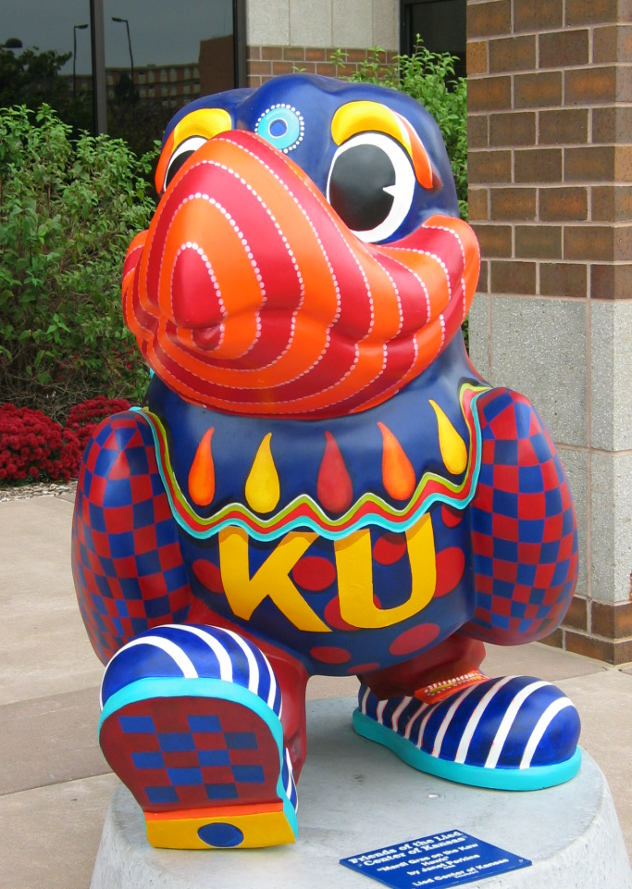
Contact
Brad Barker, Financial Analyst
Strong Hall, Suite 225
785-864-5573
barker@ku.edu
Jeff Hunter, Director of Financial
Reporting Services
Strong Hall, Suite 223
785-864-1136
jeff.hunter@ku.edu

Slide 13
Definition: Instruction
The teaching and training activities of an institution, whether they are for credit or on a non-credit basis. Includes departmental research
Departmental research: Development and scholarly activities that are not separately budgeted and accounted for.

Slide 14
Definition: Organized Research
All research and development activities of an institution that are separately budgeted and accounted for

Slide 15
Organized Research Includes:
Sponsored Research means all research and development activities that are sponsored by Federal and non-Federal agencies. This includes training individuals in research techniques
University research activities are separately budgeted and accounted for using institutional funds

Slide 16
Definition: Other Sponsored Activity
Programs and projects financed by Federal and non-Federal agencies that involve work other than instruction and organized research. (e.g... health service and community service programs)

Slide 17
Definition: Other Institutional Activities
Activities such as operation of:
residence halls
student unions
athletics
bookstores

Slide 18
Distribution of F&A Costs
Distribution is proportional to function within the University
Appropriate distribution base:
Facility costs based on functional use of space
Administrative costs based on MTDC
GA - Campus MTDC
DA - Departmental MTDC

Slide 19
Costs are reimbursable by the Federal government if they are:
ALLOWABLE: Under the circulars applicable to the award (OMB A-21)
ALLOCABLE: They can be assigned to the activity on some reasonable basis.
REASONABLE: A prudent person would have purchased this item/paid this price.
If a cost cannot meet the above criteria, it is UNALLOWABLE, no matter what it is for.

Slide 20
F & A Costs are REAL COSTS
Recovery of documented past expenditures in future awards
“…If the sponsors of research projects do not fully reimburse the costs, they must be paid from other institutional funds.”
American Council on Education

Slide 21
Contact
Brad Barker, Financial Analyst
Strong Hall, Suite 225
785-864-5573
barker@ku.edu
Jeff Hunter, Director of Financial
Reporting Services
Strong Hall, Suite 223
785-864-1136
jeff.hunter@ku.edu

